Slide 2
DCAF Training

Slide 3
Agenda
Topic | Stand Alone | Length (min) | Description
Introduction to DCAF | Yes | 60 min | 1 hour session that covers the basics of what is DCAF
RT Key Concepts Review | No | 30 min | This is a refresher of key RT concepts used in the framework.
Using LabVIEW Objects Demystifying LabVIEW Objects | Yes | 60 min | It is how to use Objects and frameworks with objects (it is not the object-oriented training by CustEd).
DCAF Components | No | 60 min | Description and deeper dive into what are the decaf components
Designing an application with DCAF | No | 30 min | How to design an application with DCAF and make modules.
Module Reuse | No | 60 min | Exercise on modules reuse
Static Modules | No | 120 min | Exercise and design of static module
Dynamic Modules | No | 180 min | Exercise and design of dynamic module
Debugging with DCAF (RT Debugging) | Yes | 60 min | How to debug DCAF
DCAF Testing and Unit Test | yes | 60 min | How to test DCAF Code
DCAF Collaboration |  | 30 min | How to collaborate with DCAF
Source Code Control and Git | Yes | 60 min | In general, all AEs should know how to use it. We will cover the basics
Systemlink with DCAF | No | 30 min | Optional Using System Link with DCAF
Introduction to Cyber Security | Yes | 60 min | Optional Covers the basic of what is encryption and security concerns
Notes:
The training full training is 2 days. Some of the topics covered are useful for AE in general and are good even if they are not taking the full training, this are marked as Stand alone.

Slide 4
Agenda
Introduction to DCAF
RT Key Concepts Review
Using LabVIEW Objects
Demystifying LabVIEW Objects
DCAF Components
Designing an application with DCAF
Module Reuse

Slide 5
Agenda
Static Modules
Dynamic Modules
Debugging with DCAF (RT Debugging)
DCAF Testing and Unit Test
DCAF Collaboration
Source Code Control and Git
Systemlink with DCAF
Introduction to Cyber Security

Slide 6

Format
Lecture and Exercises
Lectures are guidelines for discussion
Exercises are a time to experiment
Work on your project!

Slide 7
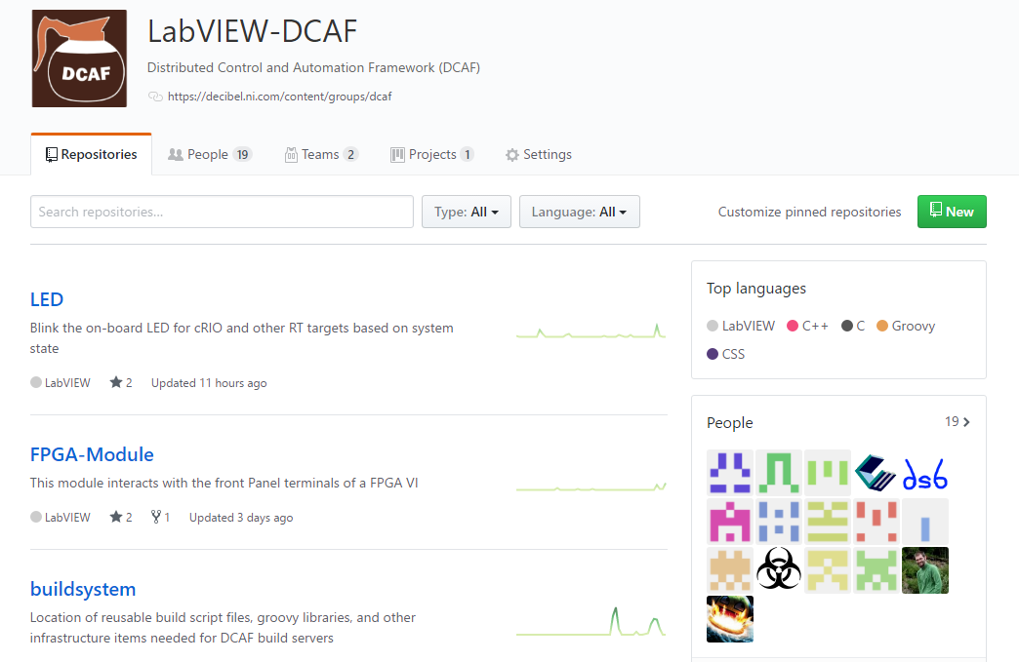
Resources
ni.com/DCAF
Getting started material
Support forum
github.com/LabVIEW-DCAF
Issue reporting
Pull requests welcome!

